Slide 1



Smart DOOR LOCK System

Slide 2
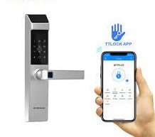
Features
Can be locked & unlocked manually as well as using mobile phone remotely.
User can be monitor the recent activity (Date, Time and State).
User can change the door password remotely.
To use mobile application user has to create user account using mobile number.

Slide 3
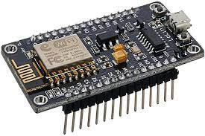
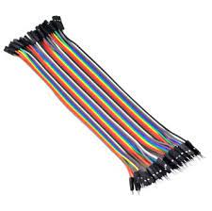
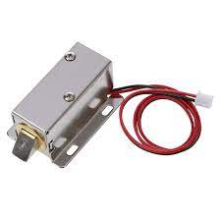
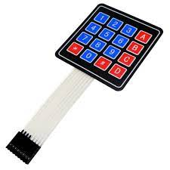
Apparatus
esp8266 board
Solenoid Door Lock
Relay Module
4x4 Keypad
Power pack
Wires

Slide 4
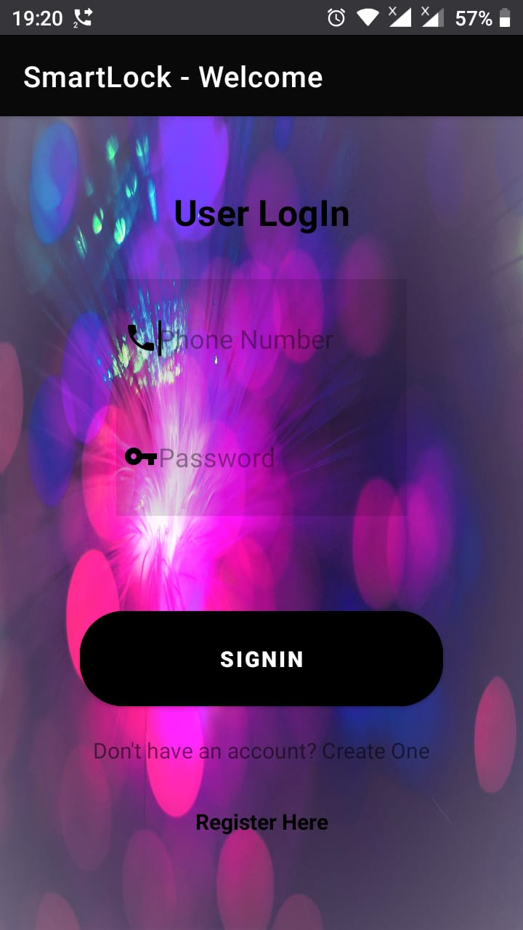
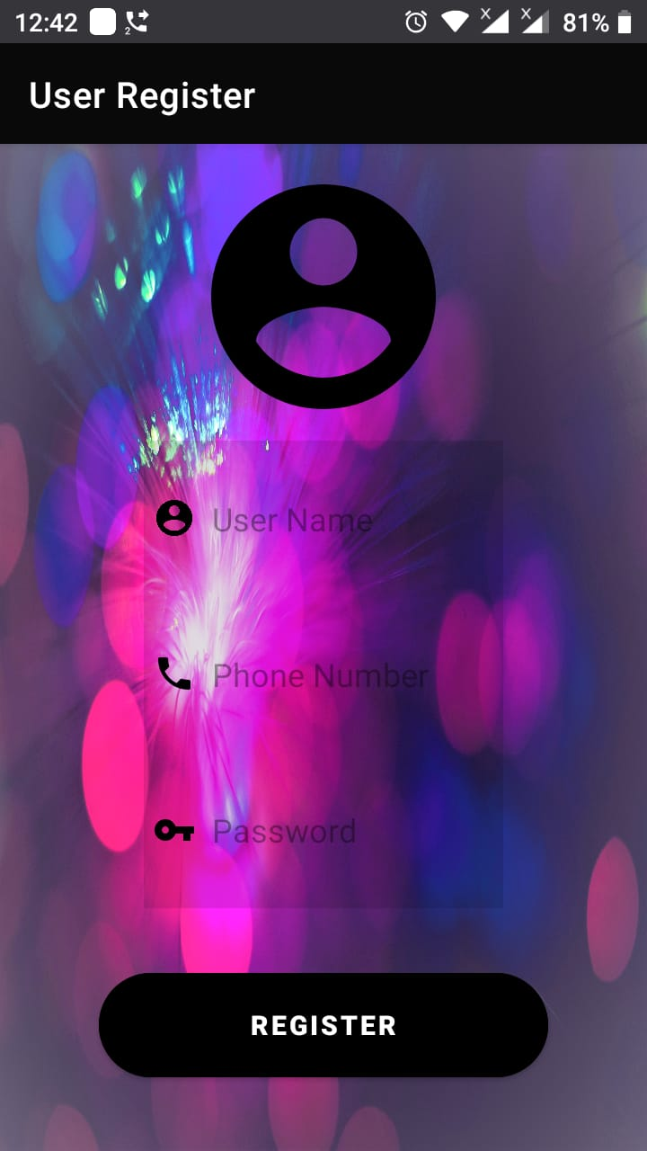
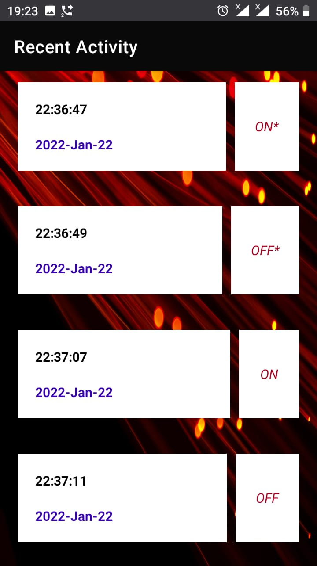
Mobile App Layouts

Slide 5
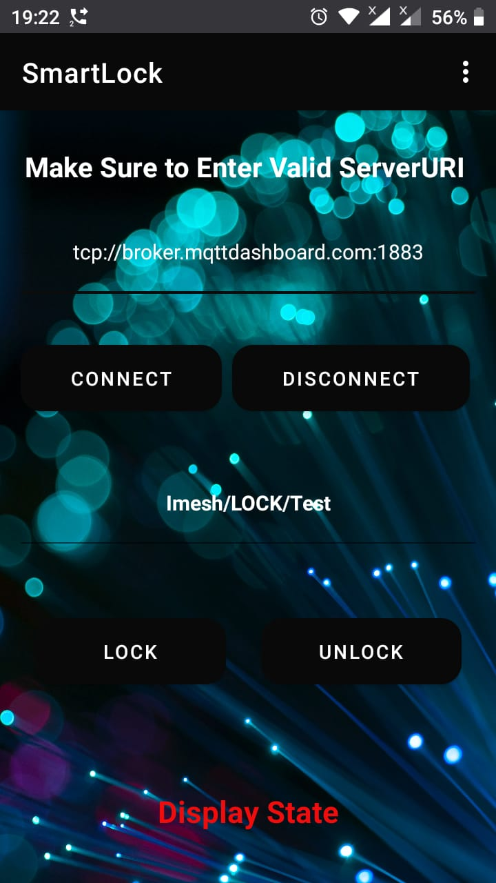
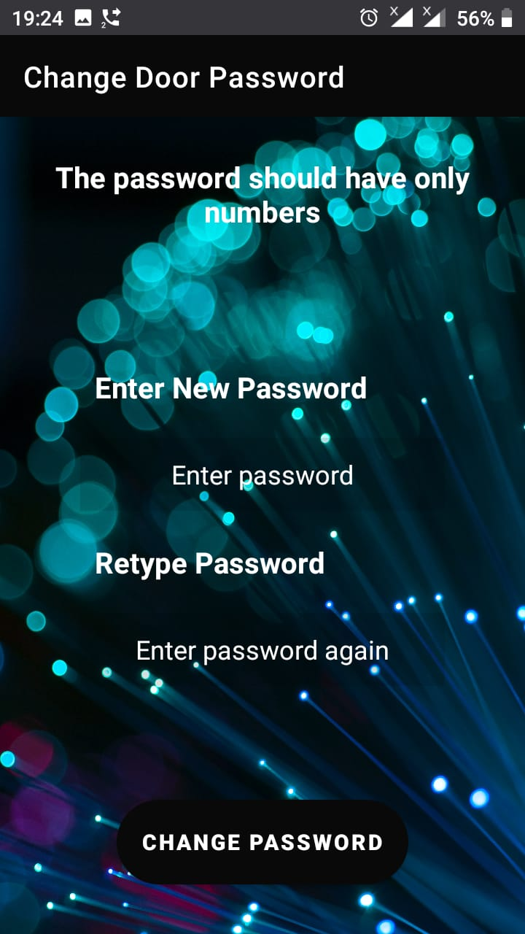

Slide 6
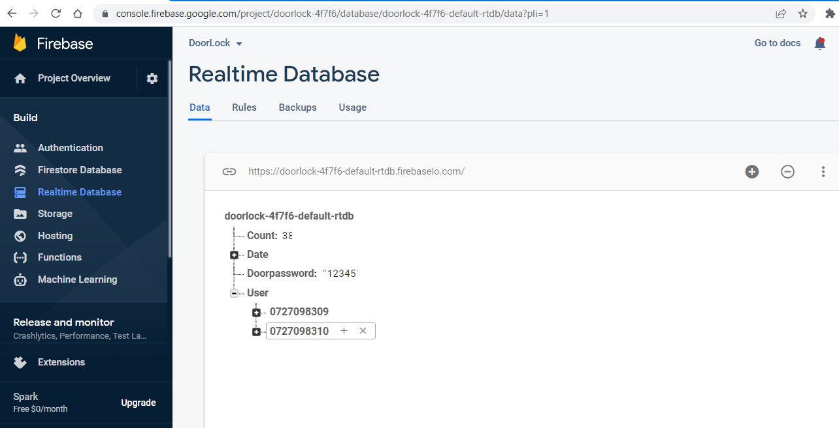
Firebase

Slide 7
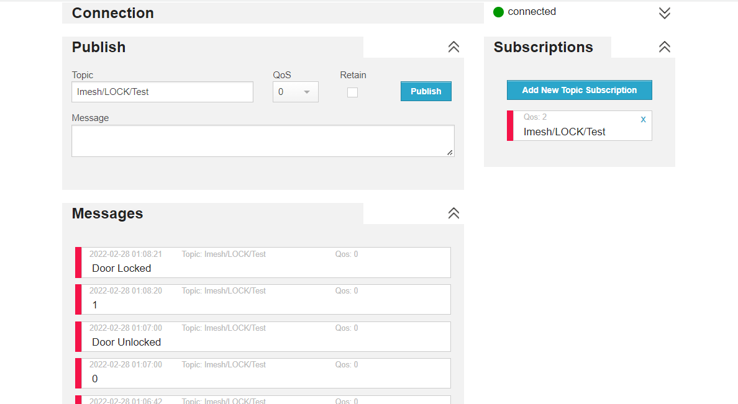
MQtt websocket client

